Slide 1
Thermodynamics and kinetics of HT-processes
Alessandro Pavese
Earth Sciences Department
University of Turin
Valperga-Caluso Street, 35
10125-Turin (Italy)
alessandro.pavese@unito.it

Slide 2
Why is high temperature thermodynamics associated with waste?

Slide 3
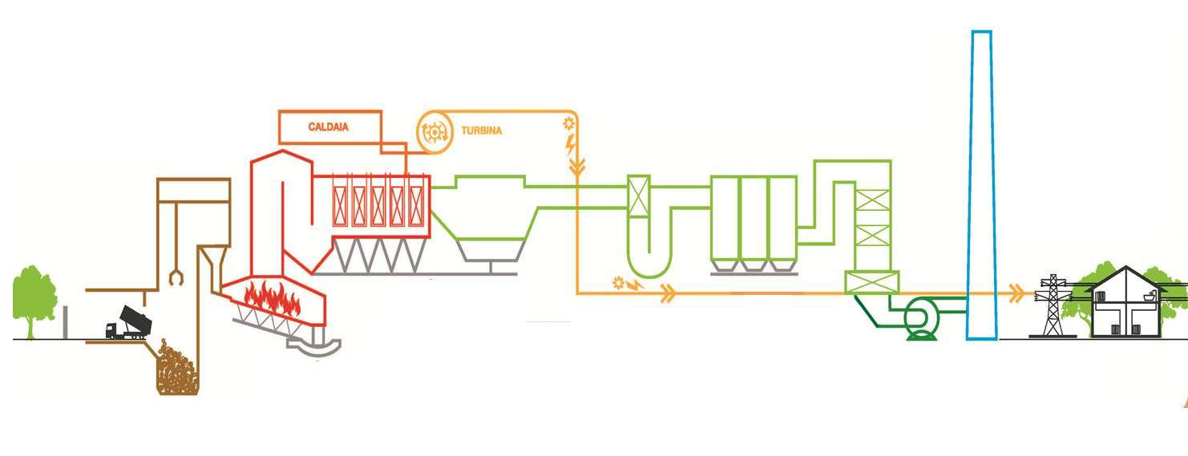
HOW A MODERN INCINERATOR WORKS
Vapour T
420 °C
SCR Reactor
Dry Reactor
120 °C
Electrostatic filter
Discharge area and storage bunker
Big Filter
Turbine
Boiler
Incineration
T > 1000 °C
Flue gases cleaning system
2=CRYSTALLIZATION FROM FLUE GAS
FLY ASHES
Grate-boiler system
1=POST-COMBUSTION FRACTION
BOTTOM ASHES

Slide 4
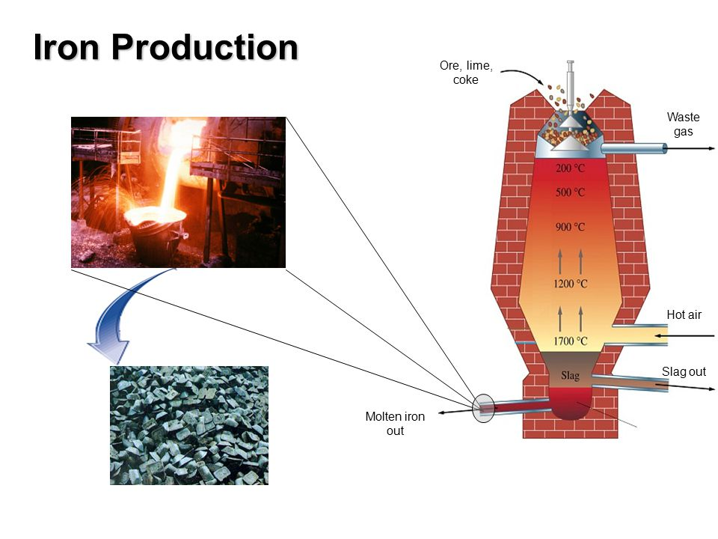
https://www.google.it/url?sa=i&url=https%3A%2F%2Fslideplayer.com%2Fslide%2F4013823%2F&psig=AOvVaw3QMKuYIQSc3O3E8tSEOp3Z&ust=1653371655691000&source=images&cd=vfe&ved=0CAwQjRxqFwoTCJCyqub39PcCFQAAAAAdAAAAABAD
200-1700 °C
SLAG PRODUCTION
COOLING DOWN PATH

Slide 5
OUR AIM TODAY
HOW CAN CLASSIC/ELEMENTARY THERMODYNAMICS
HELP US UNDERSTAND/INTERPRET COMPLEX PROCESSES,
INVOLVING WASTE PRODUCTION AND DIVERTING
FROM IDEALIT MODELS?

Slide 6
THERMODYNAMICS
HEAT
RESERVOIR
MATTER
RESERVOIR
COLLECTIVE BEHAVIOR
OF COMPLEX SYSTEMS
PHYSICAL SYSTEM
COMPLEX SYSTEMS
AUXILIARY SYSTEM
(WORK)
REVERSIBLE/IRREVERSIBLE PROCESSES

Slide 7


THERMODYNAMIC DESCRIPTION
NON-EQUILIBRIUM
EQUILIBRIUM
NON-HOMOGENEITY OF THE
PYSICAL SYSTEM
HOMOGENEITY OF THE
PYSICAL SYSTEM
THERMODYNAMIC OBSERVABLES
ARE NOT DEPENDENT ON TIME AND POSITION
THERMODYNAMIC OBSERVABLES ARE
DEPENDENT ON TIME AND POSITION
FIELD REPRESENTATION
$$ψ(\vec{x},t)$$
V, P, T,etc..

Slide 8
QUASI-STATIC TRANSFORMATIONS
SPACE OF THE TRANSFORMATIONS
B
TRANSFORMATION PATH
A
PARAMETERS OF STATE: {φ}
EQUILIBRIUM STATES
EQUATION OF STATE: EoS({φ})=0
{φ}= {P,T,V,phases/substances}

Slide 9
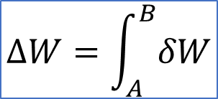

STATE VARIABLE versus PATH DEPENDENT VARIABLE
SPACE OF THE TRANSFORMATIONS
B
TRANSFORMATION PATH
PATH DEPENDENT VARIABLE=
DEPEND ON THE TRANSFORMATION
PATH
A
$$∆W=\int_{A}^{B}{δW}$$
STATE VARIABLE=
DEPEND ON THE STATE ONLY
$$∆U=U\left(B\right)−U(A)$$

Slide 10
HEAT
RESERVOIR
PHYSICAL SYSTEM
AUXILIARY SYSTEM
(WORK)
OPEN SYSTEM
MATTER
RESERVOIR
HEAT
RESERVOIR
CLOSED SYSTEM
PHYSICAL SYSTEM
AUXILIARY SYSTEM
(WORK)
INVARIANCE OF COMPOSITION

Slide 11
APPROXIMATION OF HIGH-TEMPERATURE REAL SYSTEMS
Temperature is uniform
«OPENNESS»
Composition is uniform
MATTER EXCHANGE
KINETICS
SUB-SYSTEM
QUASI-EQUILIBRATION
OCCURRENCE OF REACTIONS
IRREVERSIBLITY

Slide 12
THE EQULIBRIUM THERMODYNAMIC FRAME IS HERE USED
SIMPLICITY OF APPLICATION
ALLOWS ONE TO USE A COMPARATIVELY SIMPLE FORMALISM
PROVIDES AN INTERPRETATIVE SCHEME THAT SUFFICIENTLY FITS MOST PRACTICAL PROBLEMS, AT A FIRST LEVEL OF APPROXIMATION
ARRANGEMENTS ARE INTRODUCED TO ACCOUNT FOR EFFECTS OCCURRING IN REAL SYSTEMS

Slide 13

THERMODYNAMIC LAWS (I & II)
CONSERVATION OF ENERGY
TRANSFORMATION RESTRAINTS
$$dU=δW+δQ$$
heat can flow spontaneously from a
hot object to a cold object; heat will
not flow spontaneously from a
cold object to a hot object
internal
energy
heat
work
«DIRECTION OF A TRANSFORMATION»

Slide 14
THERMODYNAMIC REVERSIBLE/IRREVERSIBLE TRANSFORMATIONS
B
B
IRREVERSIBLE
REVERSIBLE
A
A
ONE CAN INVERT THE TRANSFORMATION PATH
ONE CANNOT INVERT THE TRANSFORMATION PATH

Slide 15
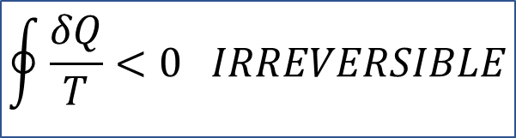


FUNDAMETAL THERMODYNAMIC VARIABLE FOR SYSTEM TRANSFORMATION
(CLOSED SYSTEMS)
CLAUSIUS THEOREM
$$\oint{\frac{δQ}{T}}<0 IRREVERSIBLE$$
$$\oint{\frac{δQ}{T}}=0 REVERSIBLE$$
$$\frac{δQ_{j}}{T_{j}}$$
ENTROPY: state function

Slide 16


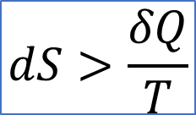
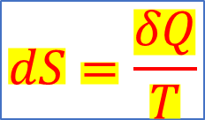

FUNDAMETAL THERMODYNAMIC THEOREM
(CLOSED SYSTEMS)
$$dS>\frac{δQ}{T}$$
Irreversible transformation
$$dS=\frac{δQ}{T}$$
Reversible transformation
$$dG_{Gibbs}=0$$
EQUILIBRIUM
$$G_{Gibbs}=U−TS+PV$$
AT GIVEN P-T
$$dG_{Gibbs} <0$$
IRREVERSIBLE TRANSFORMATION

Slide 17
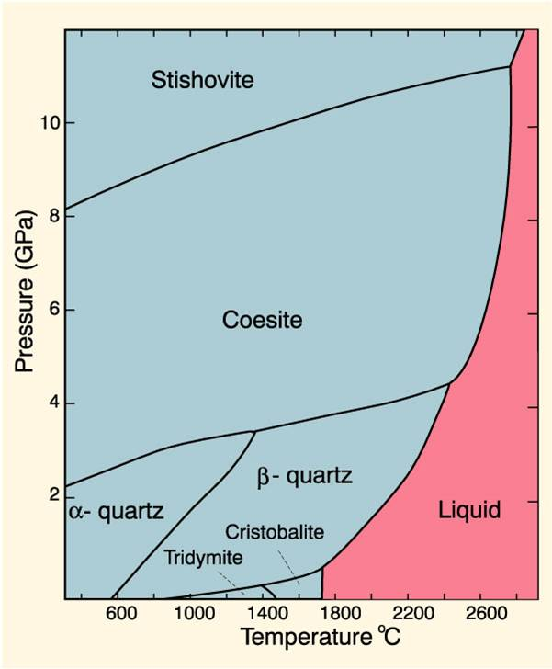

REPRESENTATION OF A P-T CLOSED SYSTEM
COMPONENTS
(for instance: SiO₂, Fe₂O₃, Al₂O₃, Na₂O, MgO, CaO, CO₂, H₂O…..)
MINIMIZATION
SiO₂
P-T
$$G_{Gibbs}=U−TS+PV$$
ASSEMBLAGE THAT MINIMIZES
THE RELATED GIBBS ENERGY
$$G_{Gibbs, stishovite}\left(P,T\right)=G_{Gibbs,coesite}(P,T)$$
Reaction equilibrium determination
ν₁A₁+ν₂A₂+………….=ξ₁B₁+ξ₂B₂+………
Gibbs(left-hand side)=Gibbs(right-hand side)

Slide 18
IRREVERSIBLE PROCESSES

Slide 19

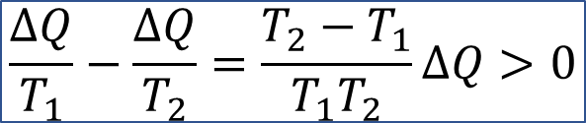
IRREVERSIBLE PROCESSES
Heat reservoir
T₁
<
T₂
Heat reservoir
T₁
T₂
$$\frac{∆Q}{T_{1}}−\frac{∆Q}{T_{2}}=\frac{T_{2}−T_{1}}{T_{1}T_{2}}∆Q>0$$
Heat reservoir
ΔQ
$$∆Q_{Reservoir}=0$$
ADIABATIC CONDITIONS
Heat reservoir

Slide 20
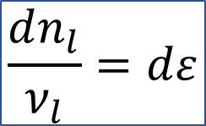
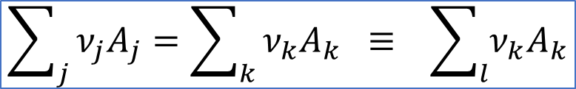
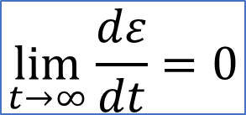
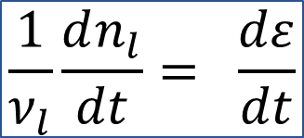
IRREVERSIBLE PROCESSES
REACTIONS
$$\sum_{j}{ν_{j}A_{j}=\sum_{k}{ν_{k}A_{k} ≡ \sum_{l}{ν_{k}A_{k}}}}$$
CLOSED SYSTEMS
$$\frac{dn_{l}}{ν_{l}}=dε$$
$$\frac{1}{ν_{l}}\frac{dn_{l}}{dt}= \frac{dε}{dt}$$
Degree of evolution or
advancement of a reaction
$$\lim_{t→∞}{\frac{dε}{dt}=0}$$

Slide 21

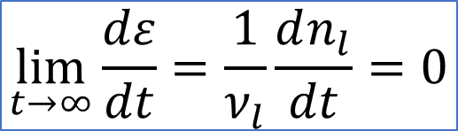

EQULIBRATION
IRREVERSIBLE PROCESSES
$$\lim_{t→∞}{\frac{dε}{dt}=\frac{1}{ν_{l}}\frac{dn_{l}}{dt}=0}$$
$${δn}_{l}=0$$
$${δn}_{l}=0$$
«STATIC» EQUILIBRIUM
«DYNAMIC» EQUILIBRIUM
FORWARD-BACKWARD REACTIONS
ν₁A₁+ν₂A₂+….
ξ₁B₁+ξ₂B₂+…

Slide 22
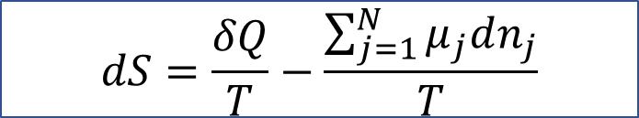
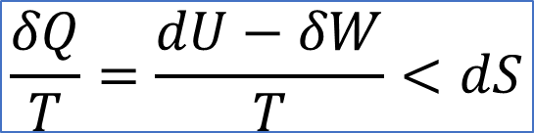
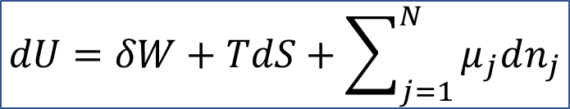

IRREVERSIBLE PROCESSES
$$\frac{δQ}{T}=\frac{dU−δW}{T}<dS$$
?
CHEMICAL POTENTIAL NOTION
$$dS_{heat exchange}+dS_{reaction}=dS$$
$$dS=\frac{δQ}{T}−\frac{\sum_{j=1}^{N}{μ_{j}dn_{j}}}{T}$$
IT ACCOUNTS FOR ENTROPY CONTRIBUTION
DUE TO IRREVERSIBILITY
$$dU=δW+TdS+\sum_{j=1}^{N}{μ_{j}dn_{j}}$$
IT ACCOUNTS FOR AN ENERGY CHANGE DUE TO A CHANGE OF COMPONENTS’ AMOUNTS

Slide 23
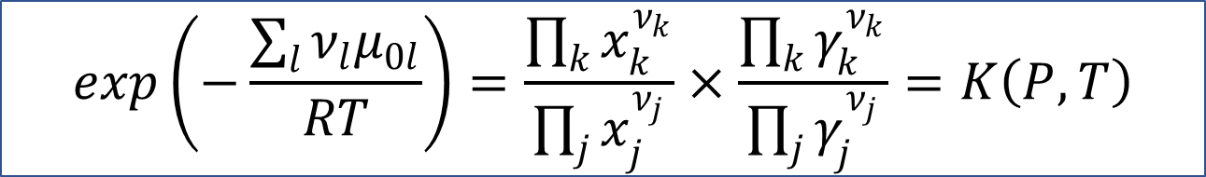
FORWARD-BACKWARD REACTIONS
ν₁A₁+ν₂A₂+….
ξ₁B₁+ξ₂B₂+…
COMPONENT/SUBSTANCE
PROPORTIONS
EQUILIBRIUM
CONSTANT
$$exp\left(−\frac{\sum_{l}{ν_{l}μ_{0l}}}{RT}\right)=\frac{\prod_{k}{x_{k}^{ν_{k}}}}{\prod_{j}{x_{j}^{ν_{j}}}}×\frac{\prod_{k}{γ_{k}^{ν_{k}}}}{\prod_{j}{γ_{j}^{ν_{j}}}}=K\left(P,T\right)$$

Slide 24
OPEN SYSTEMS

Slide 25
OPEN SYSTEMS
HOW CAN WE MODEL AN OPEN SYSTEM?

Slide 26
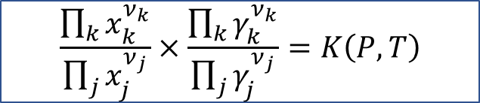
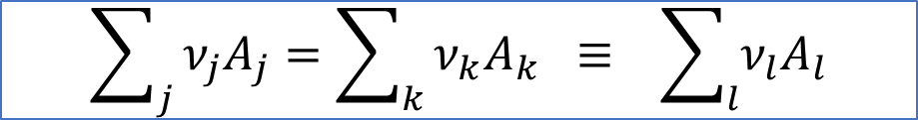

MATTER RESERVOIR
«OPENNESS»
EXCHANGE BETWEEN SYSTEM AND RESERVOIR OF A_{l} SUBSTANCES/COMPONENTS
PHYSICAL SYSTEM
OCCURRENCE OF REACTIONS
$$\sum_{j}{ν_{j}A_{j}=\sum_{k}{ν_{k}A_{k} ≡ \sum_{l}{ν_{l}A_{l}}}}$$
$$\frac{\prod_{k}{x_{k}^{ν_{k}}}}{\prod_{j}{x_{j}^{ν_{j}}}}×\frac{\prod_{k}{γ_{k}^{ν_{k}}}}{\prod_{j}{γ_{j}^{ν_{j}}}}=K\left(P,T\right)$$
MINIMIZATION OF THE «FORMATION GIBBS ENERGY»
OPEN SYSTEMS
$${∆G({composition}_{j+1})}_{formation}<{∆G({composition}_{j})}_{formation}$$

Slide 27
KINETICS

Slide 28

GENERAL ASPECTS OF KINETICS
ν₁A₁+ν₂A₂+….
ξ₁B₁+ξ₂B₂+…
$\frac{\prod_{k}{x_{k}^{ν_{k}}}}{\prod_{j}{x_{j}^{ν_{j}}}}×\frac{\prod_{k}{γ_{k}^{ν_{k}}}}{\prod_{j}{γ_{j}^{ν_{j}}}}=K\left(P,T\right)$ >> 1
REACTION
TIME
EQUILIBRIUM
t
CONVERSION RATE
α
t₁
t₂
t₃

Slide 29
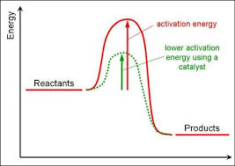
CaCO₃ → CaO+CO₂ α=CaO fraction
FUNDAMENTAL KINETIC
EQUATION
MODEL FUNCTION
CONVERSION RATE
ACTIVATION
ENERGY
PRE-EXPONENTIAL/FREQUENCY
FACTOR

Slide 30
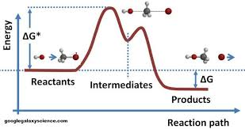
IN GENERAL
THE SMALLER A PARTICLE, THE MORE REACTIVE
IT IS, BECAUSE OF THE INCREASING ROLE OF SURFACE
surface/volume(for a sphere) ∝ 1/r
4πr² / (4/3)πr³∝1/r
Small particles promote reaction kinetics
time

Slide 31
EXAMPLES

Slide 32
EXAMPLE I
REFUSE GLASS (cullet) IN SANITARYWARE

Slide 33
SANITARYWARE PRODUCTION PROCESS
HIGH TEMPERATURE TREATMENT
CLAY
KAOLINITE
SLURRY
1230-1250 °C
QUARTZ
CAST INTO MOULDS
FELDSPAR

Slide 34
AIM
LOWERING TEMPERATURE
ACCELERATING REACTION
VITREOUS SANITARYWARE CYCLE
TIME-TEMPERATURE SPACE

Slide 35
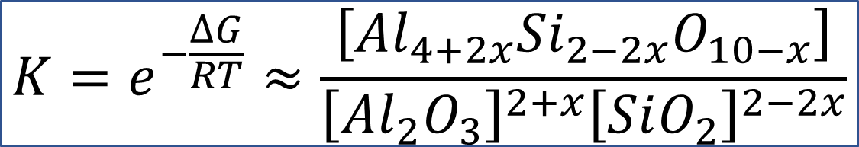
FUNDAMENTAL REACTION OF VITREOUS SANITARYWARE: MULLITE - GLASS
(2+x) Al₂O_{3,glass}+ (2-2x) SiO_{2,glass} ⇔Al_{4+2x}Si_{2-2x}O_{10-x, mullite}
$$K=e^{−\frac{∆G}{RT}}≈\frac{\left[{Al}_{4+2x}{Si}_{2−2x}O_{10−x}\right]}{{\left[{Al}_{2}O_{3}\right]}^{2+x}{\left[SiO_{2}\right]}^{2−2x}}$$

Slide 36
HOW DOES GLASS AFFECT MULLITE FORMATION REACTION?

Slide 37
α=fraction of developed mullite
Glass 0%
Glass 7%
Glass 11%
Glass 22%

Slide 39
GLASS REPLACING FELDSPAR
1200 °C
1170 °C
Modulus Of Rupture
1140 °C
REFERENCE

Slide 40
SCANNING ELECTRON
MICROSCOPY
OPTIC MICROSCOPY
(crossed Nicols):
Glass+
Micro-crystalline
Matrix: black/dark

Slide 41
EXAMPLE II
DISSOLUTION OF FLY ASH

Slide 42
FLY SHE FROM MUNICIPAL SOLID WASTE INCINERATION
DANGEROUS WASTE BECAUSE OF INSTABILITY
TREATMENTS
MORE STABLE
MATERIAL
REDUCING ITS LEACHING
OUT HEAVY METALS, SUFATE AND CHLORIDE

Slide 43
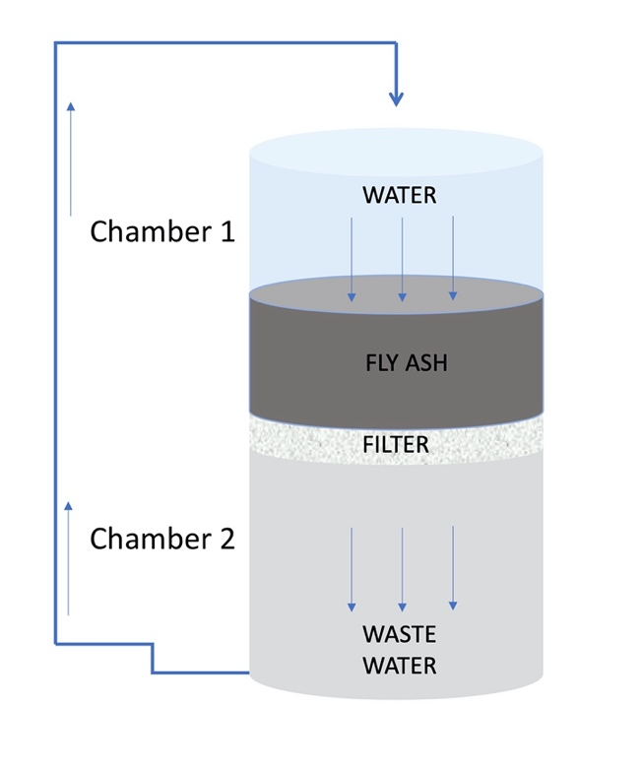
WASHING CYCLE
FALLING HEAD GEOMETRY
CYCLES’ NUMBER
CONVERSION INTO KINETICS

Slide 44
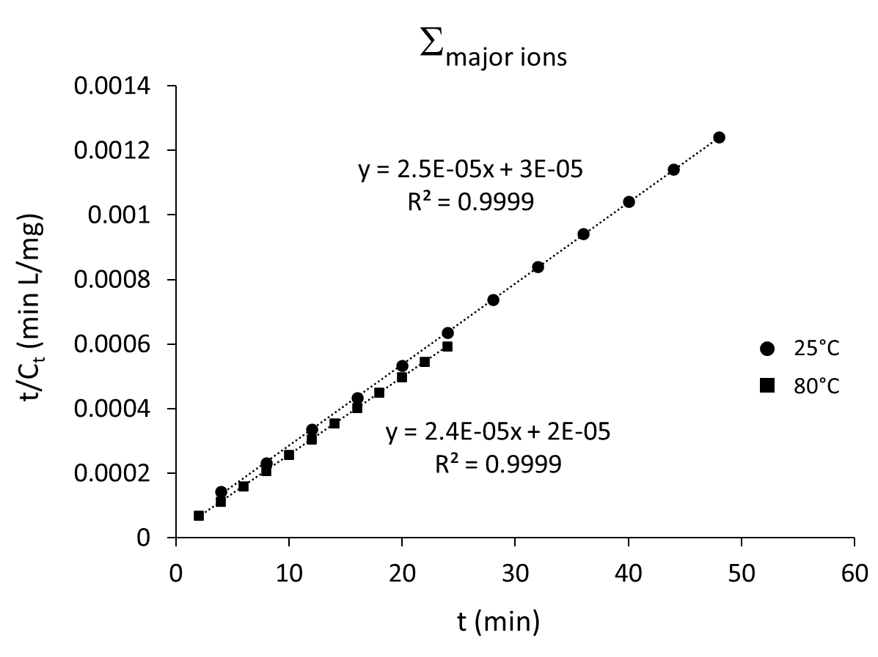
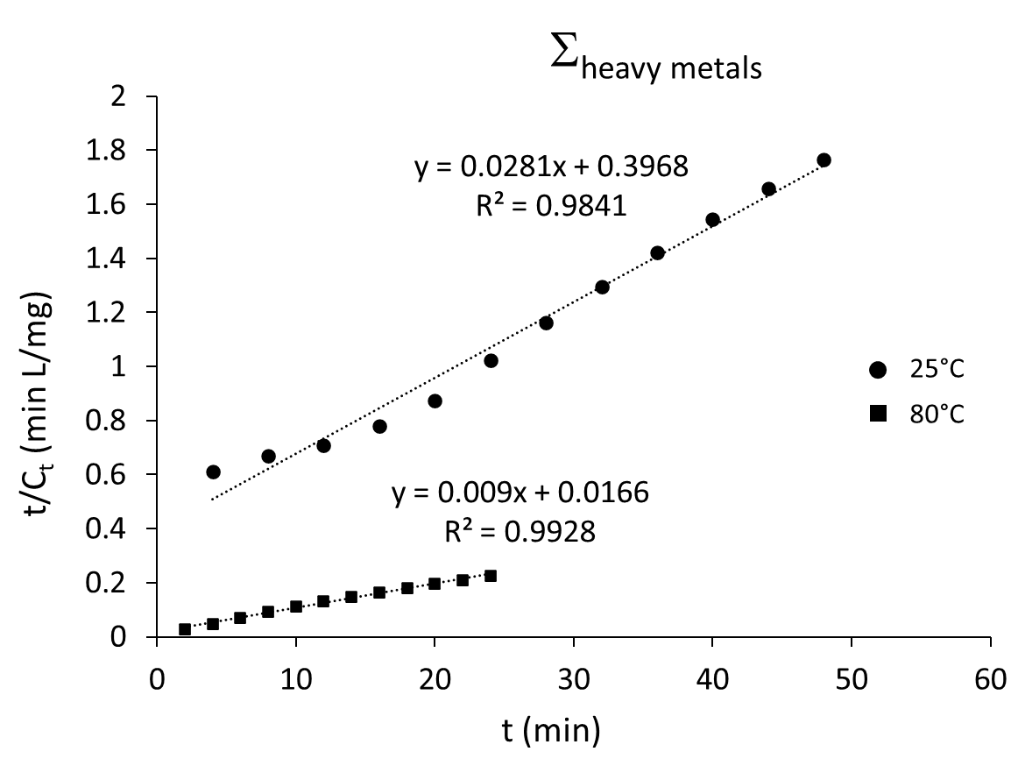
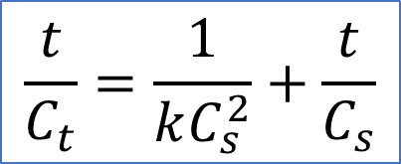
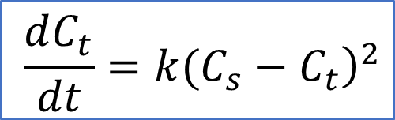
CUMULATIVE LEACHING KINETIC MODEL
$$\frac{dC_{t}}{dt}={\left.k(C_{s}−C_{t}\right)}^{2}$$
$$\frac{t}{C_{t}}=\frac{1}{kC_{s}^{2}}+\frac{t}{C_{s}}$$
C_{S}=concentration at saturation
C_{t}=concentration at time t

Slide 45
ACTIVATION ENERGY OF HEAVY METALS/MAJOR IONS LEACHING
 | lnk | 1/T (K⁻¹) | E_{a} (KJ/mol)
Σ_{heavy metals} | 8.075 | 3.2∙10⁻³ | 1.25
 | 13.52 | 2.8∙10⁻³
Σ_{major ions} | 31.6 | 3.2∙10⁻³ | 0.104
 | 31.9 | 2.8∙10⁻³

Slide 46
EXAMPLE III
P-T STABILITY FIELDS

Slide 47
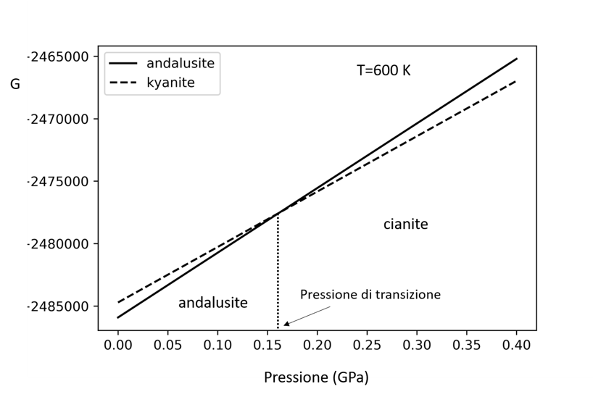
AN ELEMENTARY STABILITY FIELD STUDY
Pressure transition
determination between
polymorphs
Al₂SiO₅
at T=600 K
Gibbs energy (A.U.)
kyanite
andalusite
transition pressure
pressure

Slide 48
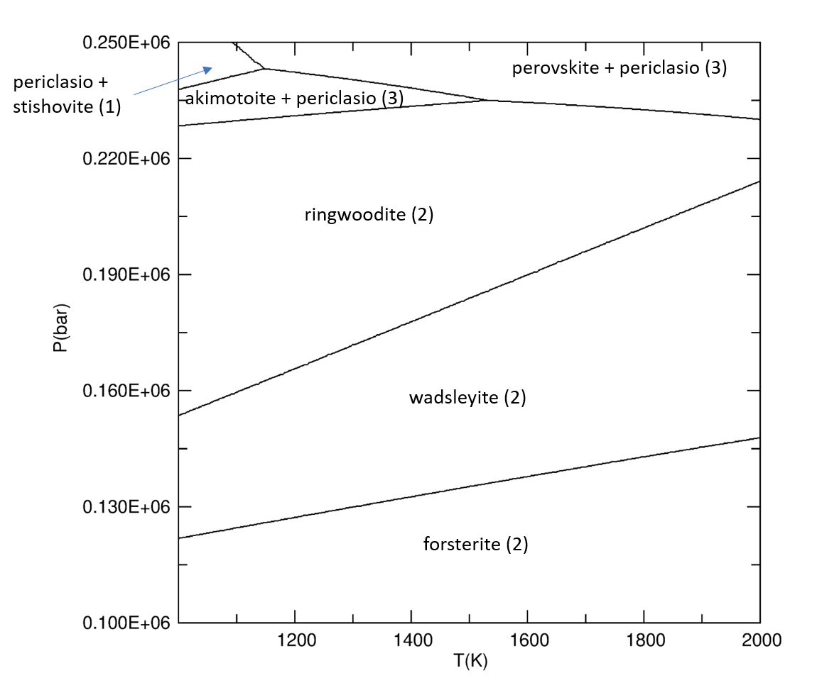
G_{akimotoite}= G_{perovskite}
G_{ringwoodite}=G_{periclase}+ G_{perovskite}
G_{ringwoodite}=G_{periclase}+
G_{akimotoite}
MgO+MgSiO₃
decomposition
G_{ringwoodite}=G_{wadsleyite}
Mg₂SiO₄
G_{forsterite}=G_{wadsleyite}
polymorphs
Mg₂SiO₄

Slide 49
CONCLUSIONS
1
THERDYNAMICS PROVIDES POWERFUL TOOTLS FOR INTERPRETATION OF LARGE SCALE PROCESSES
2
DEVIATIONS FROM IDEAL CONDITIONS OR STANDARD MODELLING MUST BE ACCOUNTED FOR
3
THREE ORIGINS OF DEVIATIONS: CHEMICAL «OPENNESS» OF SYSTEMS (NON-CONSERVATION OF MASS), OCCURRENCE OF REACTIONS (IRREVERSIBILITY) AND OFF-EQUILIBRIUM (KINETICS)
4
STANDARD MODELLING: GIBBS ENERGY MINIMZATION
5
OPEN SYSTEM/IRREVESIBILITY: FORWARD-BACKWORD REACTIONS FORMALISM
6
REACTION KINETICS AND ITS EXTENSIONS
MUCH IS STILL TO BE DONE! NEW IDEAS ARE WELCOME!

Slide 50
THANK YOU FOR YOUR ATTENTION!

