Slide 1
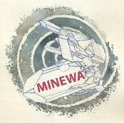
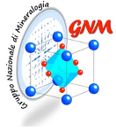
Minerals and waste, an overlooked connection
MINEWA
Minerals and waste, an Anthropocene tale,
Bardonecchia (Torino, Italy) 20-24 June 2022
Mario Tribaudino
Department of Earth Sciences, University of Torino

Slide 2
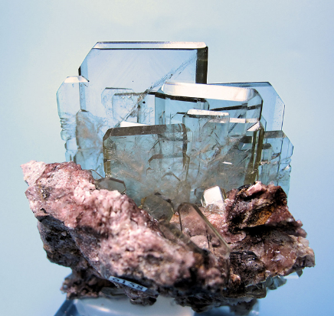
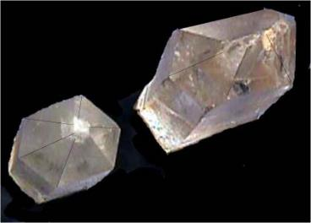
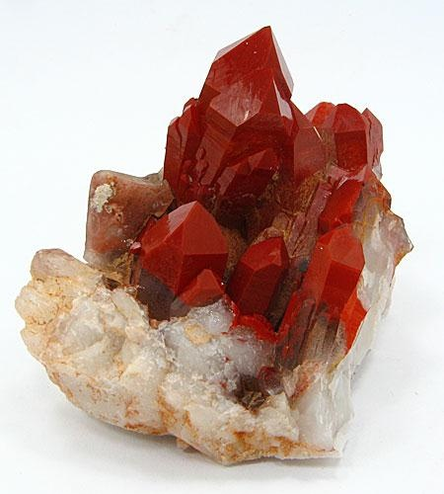
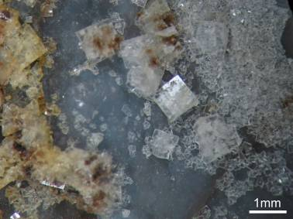
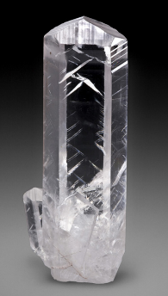
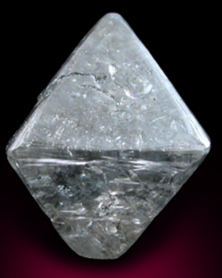
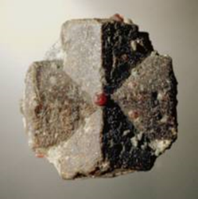
Minerals? Fancy crystals?

Slide 3
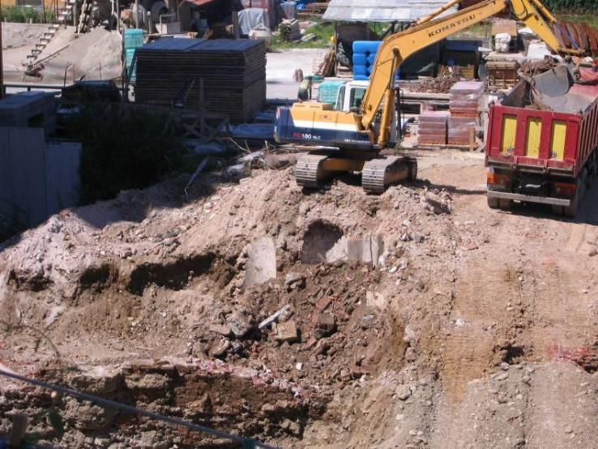
The real world
quartz, calcite, clay minerals, iron oxides and hydroxides…
tobermorite, portlandite, monosulphate minerals…

Slide 4
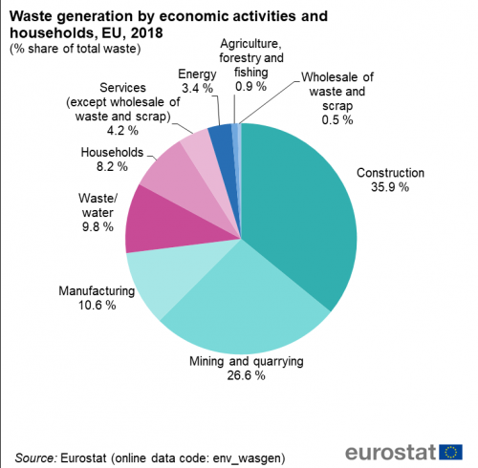
Minerals, where?
Mining quarrying: minerals as they are, but ground, pulverized, reactions for extraction, reactions in the environment, oxidaytion, bio-mediated reactions
Construction: transformations involving minerals and producing minerals
Manufacturing: production ofmaterial generally unstable at earth condition: some are common minerals, other will become so sooner or later
Waste water: not mineral, but reacts with minerals
Households: not minerals, but the ashes will be

Slide 5
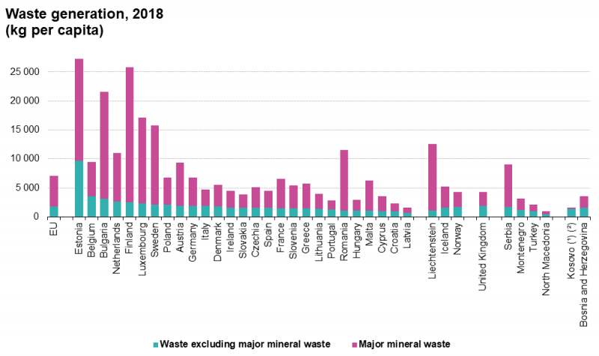
Minerals, where?
Eurostat: major mineral waste
A lot of the waste from mining and quarrying and from construction and demolition is classified as major mineral waste. Almost three quarter (74 % or 5.2 tonnes per inhabitant) of the total waste generated in the EU in 2018 was major mineral waste.
To compare: about 0.5 tonnes per inhabitant MSW
Major mineral waste

Slide 6
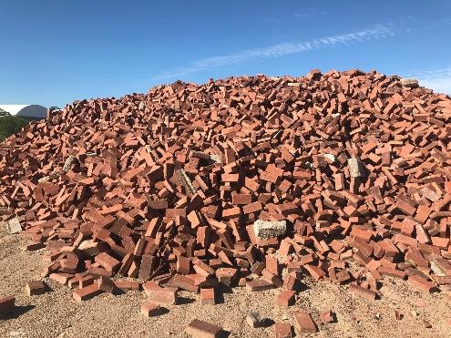
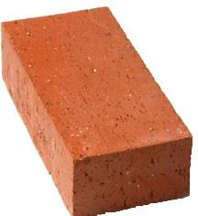
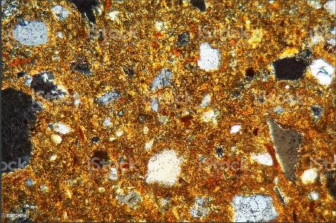
Minerals where?
Brick composition: 20-30% Al₂O₃
50-60%SiO₂
<5%CaCO₃ Fe₂O₃<5%
Is this enough? Does it explain something?
Like saying human body is 65% o, 18 C, 10H, and minor Ca, P and N.
Construction and demolition waste
Bricks are made of minerals:
quartz, feldspar, hematite, mullite, muscovite…
Reactions change with grain size and distribution…

Slide 7
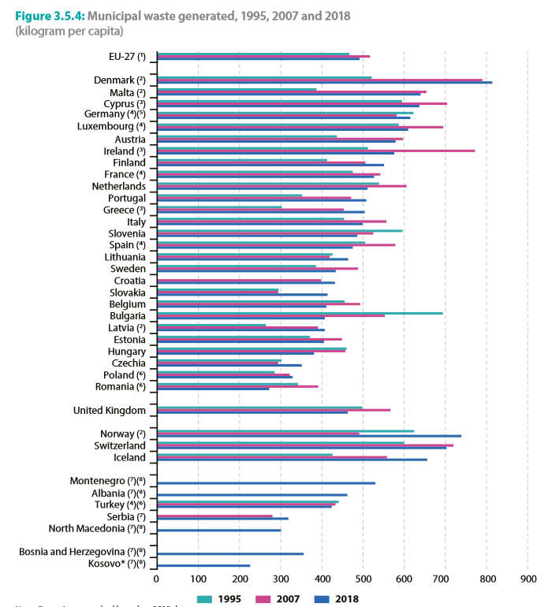
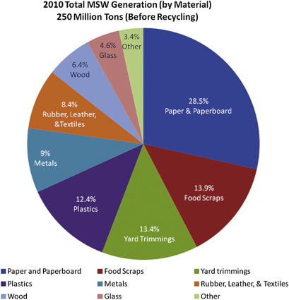
Minerals, where?
Municipal solid waste
Seemingly not mineral waste, but, let’s see the processes

Slide 8
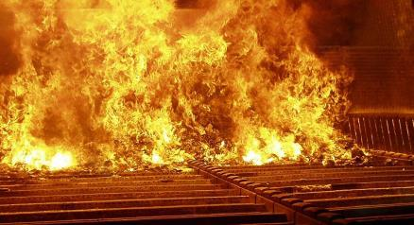
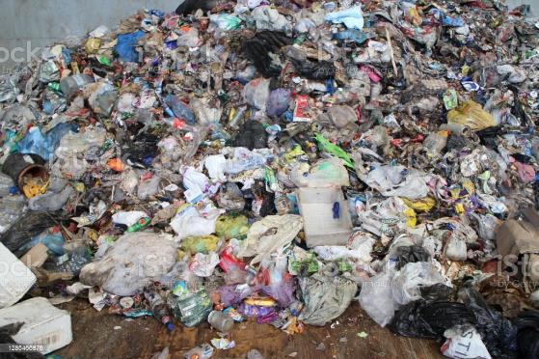
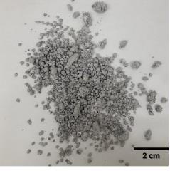
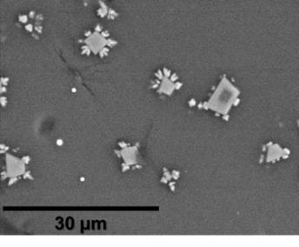
Minerals, where?
You do not see fancy crystals, but reactions are the same as in natural minerals
Spinels in glassy matrix, with droplets of metal iron
What and how to do means something that happens between minerals

Slide 9
Minerals, why?
Possible reuse and recycling
construction
concrete
aggregate
road pavement
ceramics
recovery of «green» elements
…
Assess performance, show problems, suggest solutions, define geochemical conditions of release and feezing
Geochemical hazard
release of potentially toxic elements (PTE)
powder particles in the air
Typical paths: what is present, how does it react with the environment and in the reuse-recycle conditions

Slide 10
The minerals and waste triangle
Chemical an mineralogical composition, texture (grain size and shape, relations with other mineralsgrains)
What is present
Analytical methods.
Granulometry, OM, XRD, SEM-EDS, ICP-Ms, XRF, TGA, DSC…
Here is most interest
What can we do with it
Which are its properties
Development of a new technology product
Performance tests, pre-production breadbord…
Reactivity to different chemical and physical stimuli
Leaching tests, selective extraction, in vitro biological tests…

Slide 11
Minerals, when?
Used as such
aggregate
road embankment
…
Formed during production
clinker: clay+ CaCO₃ → C₂S, C₃S, C₃A, C₄AF
as minerals named: larnite (C₂S belite), hatrurite (C₃S alite), not a mineral! (C₃A celite), brownmillerite (C₄AF)
concrete: cement+aggregate (most minerals)
cement: clinker →ettringite (AFt phase), tobermorite (C-S-H), portlandite (CH), (AFm phases, like stratlingite)…
ceramics: caolinite + quartz + feldspar +…→ glass (not a mineral), quartz, mullite…
MSWI bottom ashes: glass, quartz, portlandite, ettringite, gehlenite…
Formed during weathering
carbonates and sulphates, often soluble

Slide 12
Minerals, what? What is a mineral: geoscience vs waste management
Geoscience
Solid (no water waste)
Inorganic compound (no plastic, no wood)
Crystalline (no glass)
Natural (no waste? no metals?)
Defined composition, in most cases compositional range
Waste management
Solid
Inorganic, but often mingled with organic
Crystalline and amorphous
Seldom natural (e.g. rock aggregate)
Composition and structure same or very similar to natural ones
Mineral names because they are found somewhere in nature

Slide 13
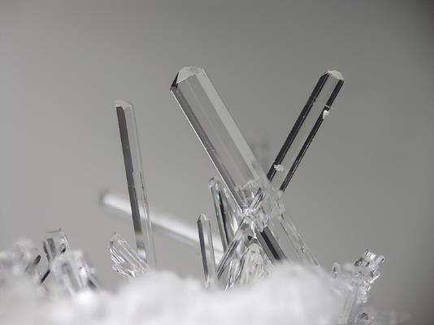
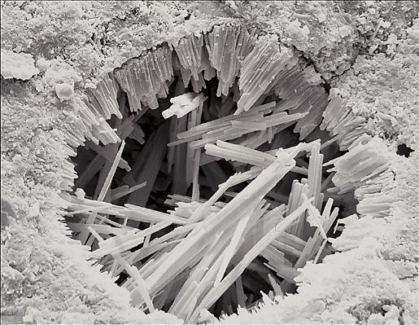
The same chemical compound, same crystal structure, same reactions, same potential uses, can be or not a mineral according to common definition
ettringite
Quarry near Ettringen
cement, delayed ettringite formation
Rare, mineral
Most common, mineral?
Most compounds in waste and in general industrial products have a counterpart in nature, some in exotic rocks
Example: hatrurite, burning of bitumen in a marl
Si (silicon), highly reducing conditions, possible contamination
In waste management they are all minerals

Slide 14
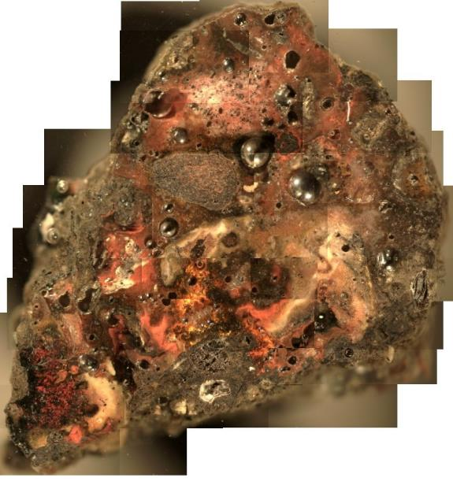
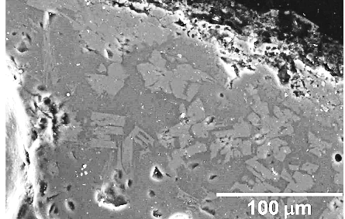
Minerals, who?
An example: glass and crystals in MSWI BA
Residual glass: original unreacted glass
Newly formed glasses: reactions in local equilibria
white glass
melilite and glass
red glass

Slide 15
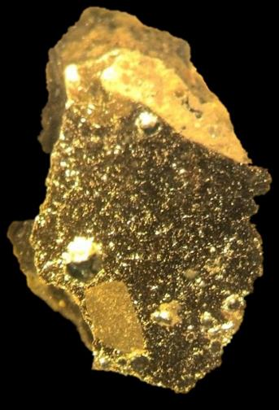
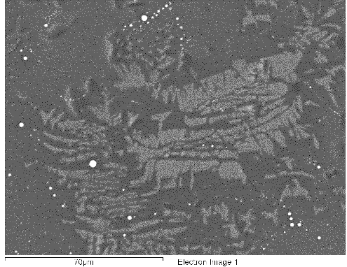
Local equilibria in 1x2mm² grain in bottom ashes from MSWI
metal Fe
wollastonite (CaSiO₃)
alkali rich glass

Slide 16
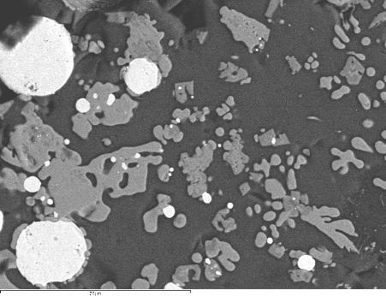
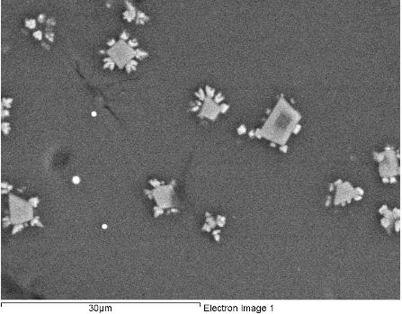
Fe-Ti oxide
Fe oxide
metal Cu
glass
Fe-Ti-Ca oxide
(spinel stoichiometry)
Cu-Sn alloy
glass

Slide 17
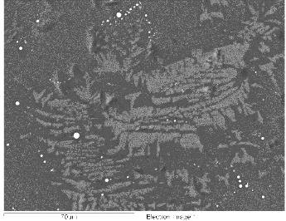
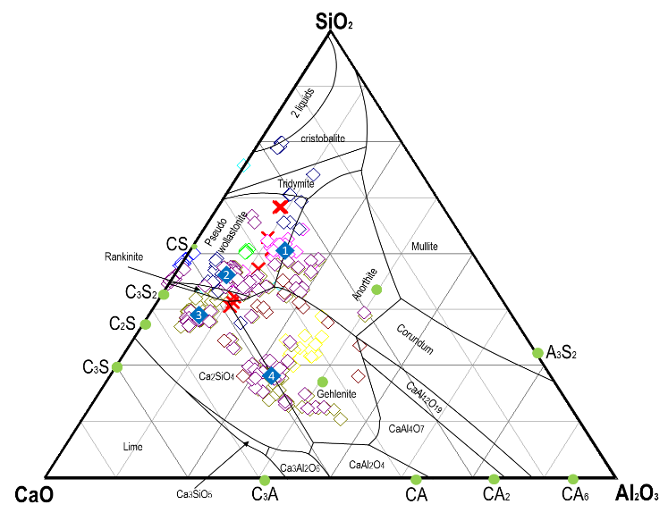
Several glasses and several equilibrium phases

Slide 18
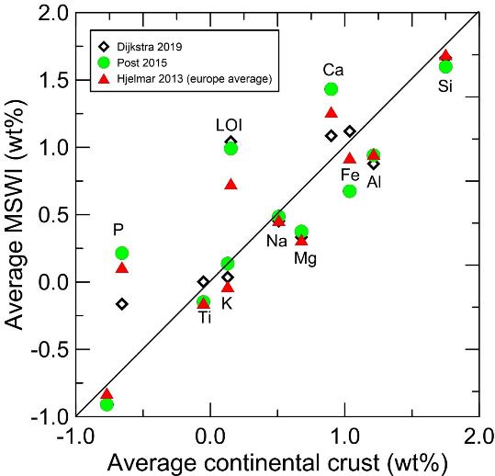
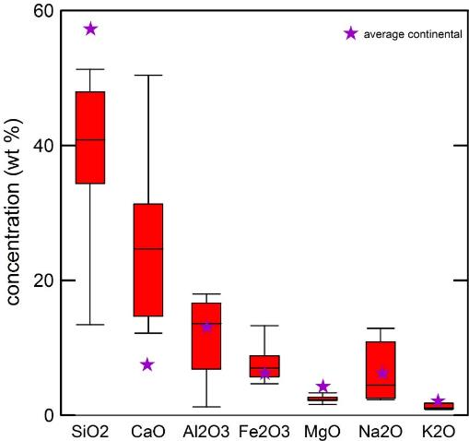
To end, a geochemical perspective
Comparing continental crust and MSWI BA
Ca-Si-Al main elements (Si-Al-Fe in CC)
Enriched in Ca and LOI (carbonates, cement minerals…)
High P, organic matter (bones…)
Generally waste follow the same pattern as CC
The actual distribution
The average

Slide 19
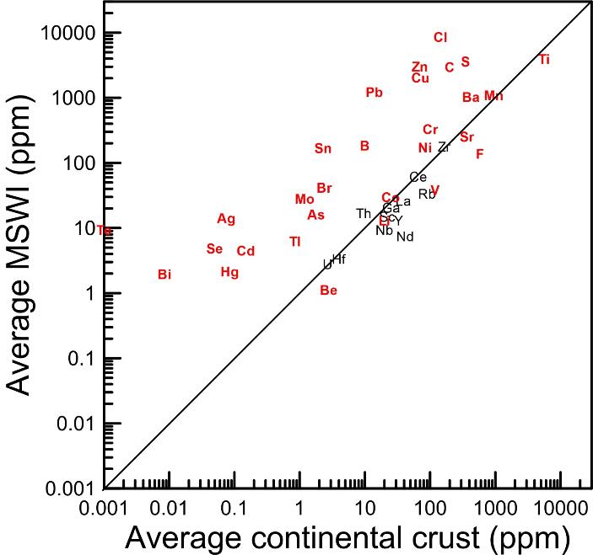
Minor elements (less than 1%)
Two groups:
the same (or little less) than continental crust
enriched in waste
Fate:
Forming their own mineral (e.g.NaCl for Cl, CaSO₄ for S)
Entering in solid solution

Slide 20
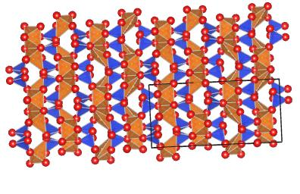
Where are the minor elements?
The crystal chemical picture is that of oxygen with interstitial space, centered in polyhedra. It is ordered in crystals, disordered in amorphous.
Some elements may be dispersed in crystalline and glassy solid solutions, other form their own phase, other both.
An example, Zn…

Slide 21
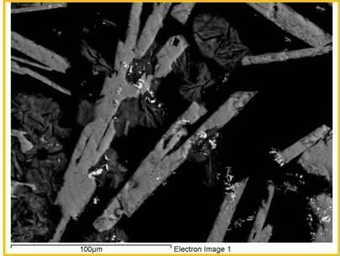
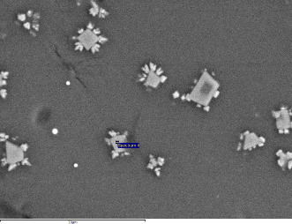
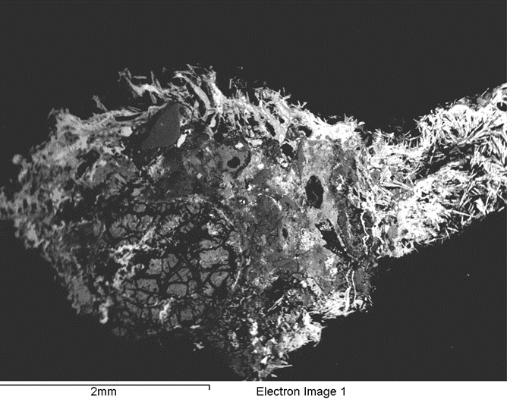
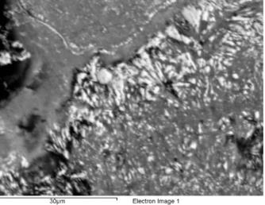
In MSWI BA from Parma, we have found Zn as:
Global Zn is 3200 ppm
Less than 2000 ppm dispersed in glass: solid solution in glass
Ca[Zn₂(OH)₆].2H₂O
Zn(OH)₂
Solid solution in crystals (spinel 2000-14000 ppm)

Slide 22
Conclusions: minerals in waste
Where: minerals are the main constituent of wastes, either in construction and demolition, and in municipal and industrial residues
When: we have minerals from the original rock, inaltered (e.g. concrete aggregate), formed during the industrial processes, or during weathering
What: Definition of minerals in waste management is wider than most accepted in mineralogy: incluses metals, minerals from non natural processes, even if without natural counterpart, and glasses
Who: we can find almost any mineral: common rock forming, like quartz, calcite, feldspars, seldom find in nature like ettringite, very rare in nature, but common in man-made manufactory, like hatruite (C3S), absent in nature like celite or non-mineral, like glass
Why: we want to reuse mineral waste, or recycle in some non-harmful way. Therefore we must know the properties of our minerals.
And now let’s begin!

Slide 23
Thank you for your attention

Slide 24
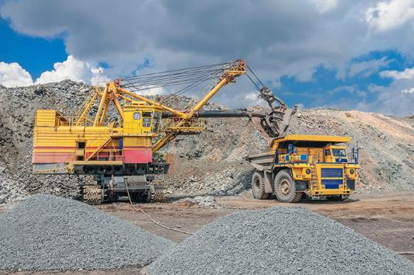
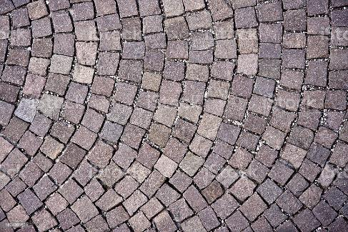
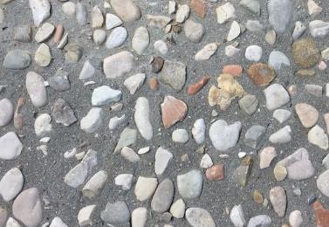
Minerals: when
Natural minerals
mining and quarrying
aggregate in concrete
road pavel
…
Mostly mining and quarrying and construction and demolition wastes

